Slide 1


Ajax & Vue.js
Asynchronous and Reactive
Let’s Go

Slide 2

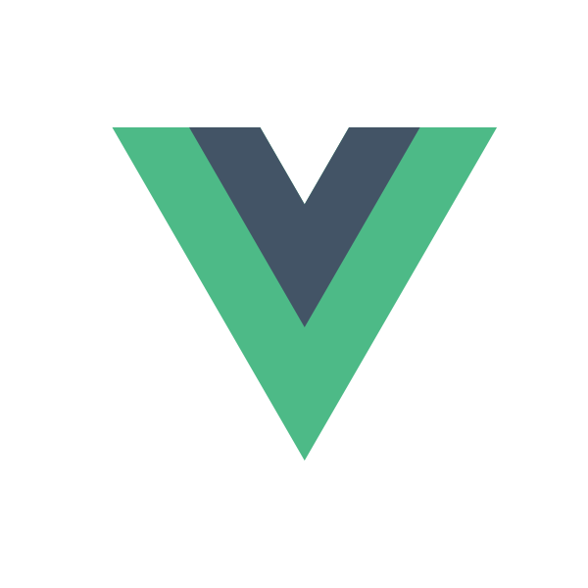

New concepts
New concepts are coming...
AJAX
Vue.js

Slide 4
What is AJAX ?
“Ajax is a set of Web development techniques.
With Ajax, Web applications can send and retrieve data from a server asynchronously (in the background) without interfering with the display and behavior of the existing page.”
Wikipedia

Slide 5
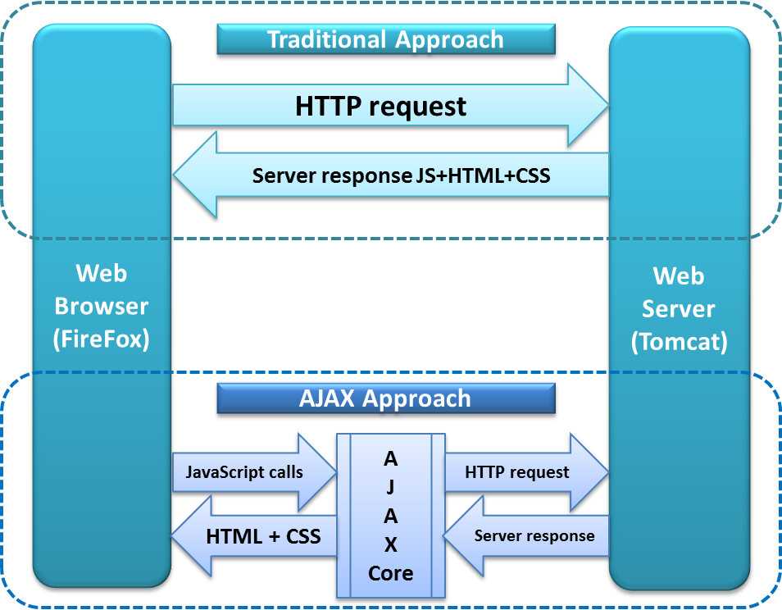
What is AJAX ?
Without AJAX every request responds with a whole HTML file.
With AJAX we can only return data to update the content without refreshing the page.

Slide 6
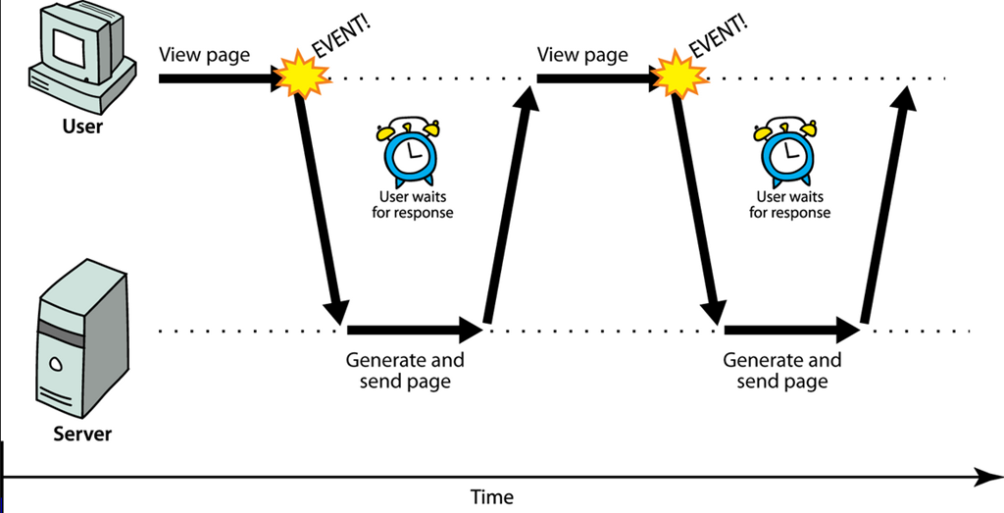
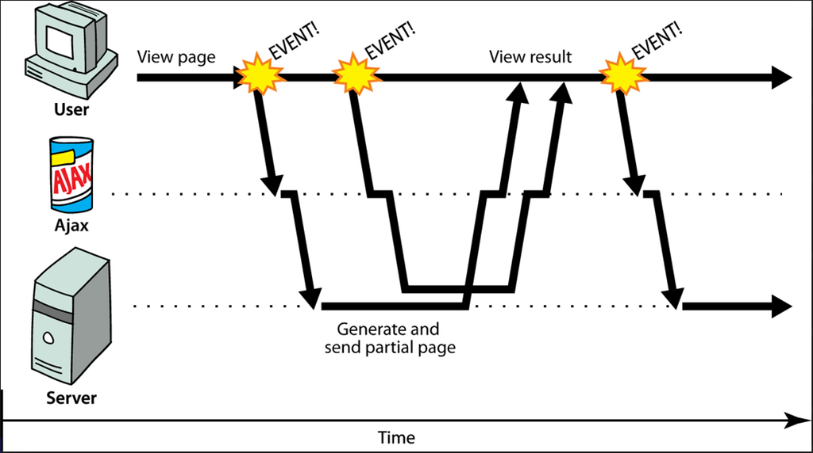
Synchronous VS Asynchronous
Your program starts at the first line of source code and each line of code executed sequentially thereafter.
You are essentially saying, “I know this function call is going to take a great deal of time, but my program thread doesn’t want to wait around while it executes.

Slide 7
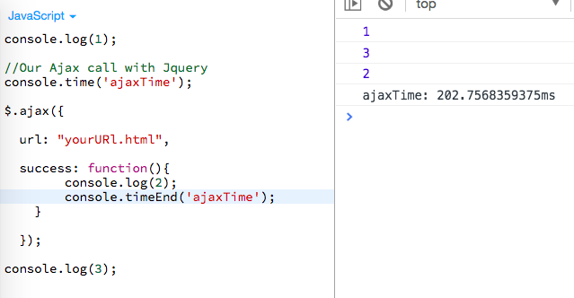
Example:
We can see how our Ajax call spends more than 200ms, our code is faster than that, for this reason we see the “3” before the “2” in our console.

Slide 8
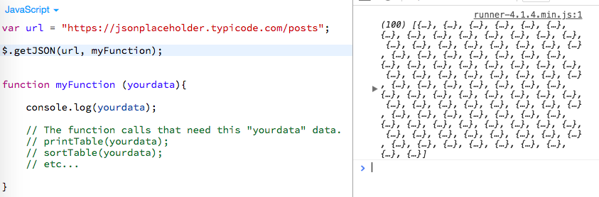
Example:
This $.getJSON() function is a shortcut to make Ajax calls expecting for a JSON in the response. This response is stored in the yourdata var inside the function called. This is called CallBack. When the data arrives you can call the functions that need this new data.
Only here we are sure that the data exists.

Slide 9
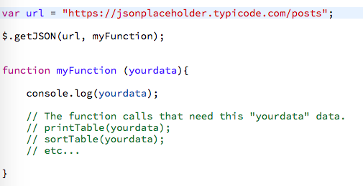
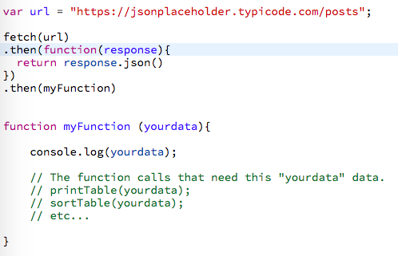
$.getJSON VS Fetch:
You can make Ajax calls only with Javascript.
The fetch method needs two promises (read about that) but the syntax is so similar to the $.getJSON() function.

Slide 10
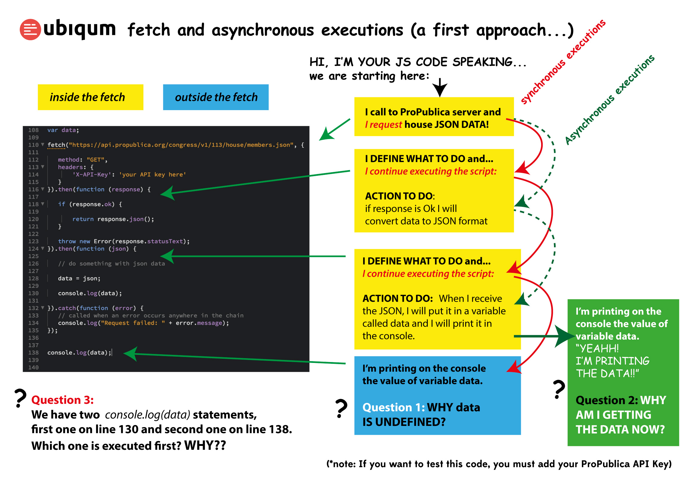

Slide 11
What is VUE ?
“Vue.js is a popular JavaScript front-end framework that was built to organize and simplify web development.”
Wikipedia

Slide 12
The power of Vue.js ?

Slide 13
Thanks for Watching

